Slide 1

Linear Regression
Let’s learn something!

Slide 2
Python and Spark
The Linear Regression section has:
Theory Overview Lecture
Documentation Example
Custom Code Example
Consulting Project Exercise

Slide 3
Python and Spark
A quick note, if you’ve already gone through another course of mine that has Machine Learning topics, you may have already seen this material!
Feel free to skip the rest of this, the theory of linear regression hasn’t changed :)

Slide 4
Reading Assignment
Chapters 2 & 3 of
Introduction to Statistical Learning
By Gareth James, et al.

Slide 5
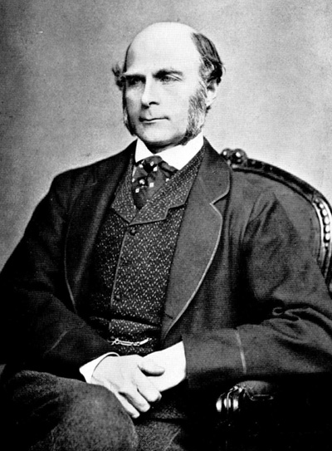
History
This all started in the 1800s with a guy named Francis Galton. Galton was studying the relationship between parents and their children. In particular, he investigated the relationship between the heights of fathers and their sons.
Math &
Statistics
Machine Learning
DS
Software
Research
Domain
Knowledge

Slide 6
History
What he discovered was that a man's son tended to be roughly as tall as his father.
However Galton's breakthrough was that the son's height tended to be closer to the overall average height of all people.
Math &
Statistics
Machine Learning
DS
Software
Research
Domain
Knowledge

Slide 7

Example
Let's take Shaquille O'Neal as an example. Shaq is really tall:7ft 1in (2.2 meters).
If Shaq has a son, chances are he'll be pretty tall too. However, Shaq is such an anomaly that there is also a very good chance that his son will be not be as tall as Shaq.
Math &
Statistics
Machine Learning
DS
Software
Research
Domain
Knowledge

Slide 8
Example
Turns out this is the case: Shaq's son is pretty tall (6 ft 7 in), but not nearly as tall as his dad.
Galton called this phenomenon regression, as in "A father's son's height tends to regress (or drift towards) the mean (average) height."

Slide 9
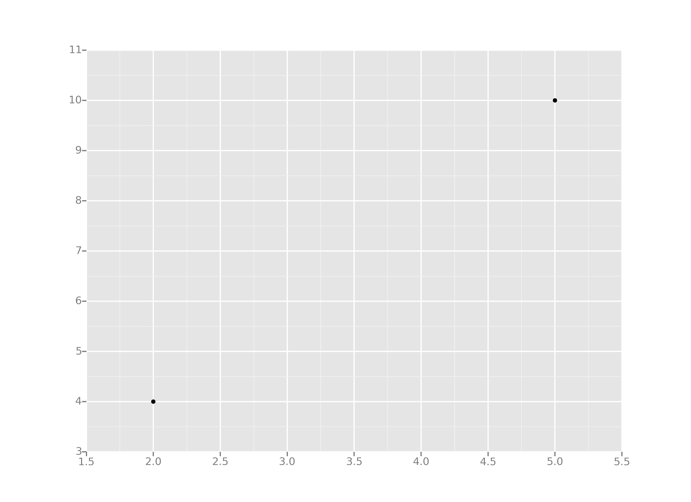
Example
Let's take the simplest possible example: calculating a regression with only 2 data points.

Slide 10
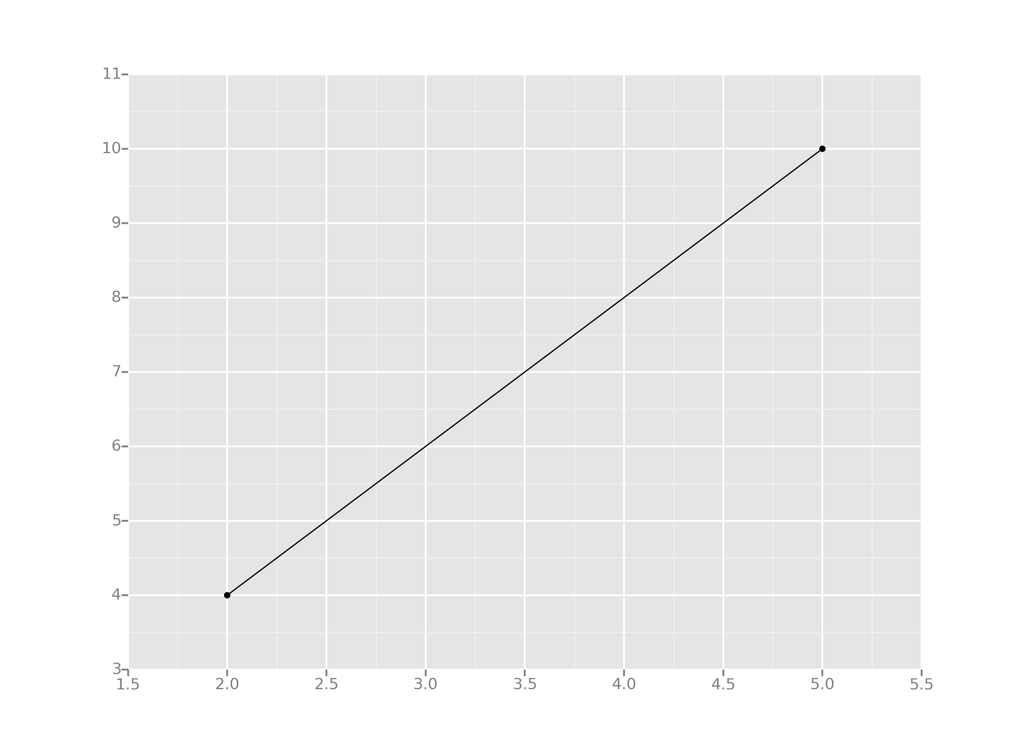
Example
All we're trying to do when we calculate our regression line is draw a line that's as close to every dot as possible.
For classic linear regression, or "Least Squares Method", you only measure the closeness in the "up and down" direction

Slide 11
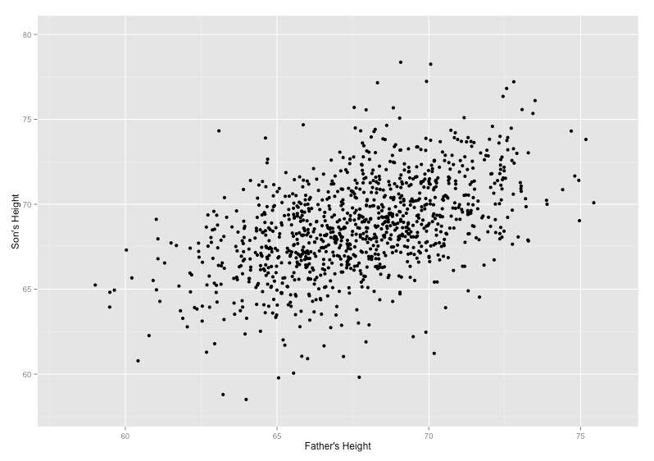
Example
Now wouldn't it be great if we could apply this same concept to a graph with more than just two data points?
By doing this, we could take multiple men and their son's heights and do things like tell a man how tall we expect his son to be...before he even has a son!

Slide 12
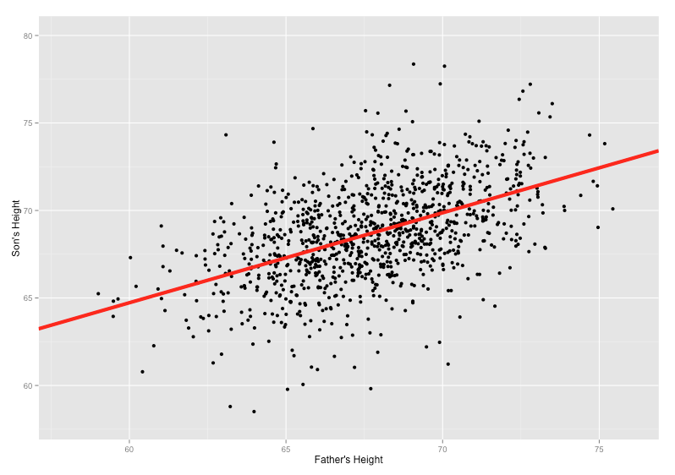
Example
Our goal with linear regression is to minimize the vertical distance between all the data points and our line.
So in determining the best line, we are attempting to minimize the distance between all the points and their distance to our line.

Slide 13
Example
There are lots of different ways to minimize this, (sum of squared errors, sum of absolute errors, etc), but all these methods have a general goal of minimizing this distance.

Slide 14
Example
For example, one of the most popular methods is the least squares method.
Here we have blue data points along an x and y axis.

Slide 15
Example
Now we want to fit a linear regression line.
The question is, how do we decide which line is the best fitting one?

Slide 16
Example
We’ll use the Least Squares Method, which is fitted by minimizing the sum of squares of the residuals.
The residuals for an observation is the difference between the observation (the y-value) and the fitted line.

Slide 17
Python and Spark
Now let’s get an idea of how to implement this idea with PySpark!
Will ease into all of this by checking out the simpler documentation example first!

Slide 18
Linear Regression
Documentation Example

Slide 19
Python and Spark
While it may not be super interesting, understanding how to read and re-apply documentation examples will rapidly speed up your own learning process!
Let’s walk through the Linear Regression Documentation Example!

Slide 20
Python and Spark
In the browser we’ll have:
Documentation Page
Data from Documentation
Linear_Regression_Example.ipynb
New Untitled Notebook

Slide 21
Evaluating Regression

Slide 22
Python and Spark
Let’s take a quick break to discuss evaluating Regression Models
Not just Linear Regression, but any model that attempts to predict continuous values (unlike categorical values, which is classification)

Slide 23
Python and Spark
You may have heard of some evaluation metrics like accuracy or recall.
These sort of metrics aren’t useful for regression problems, we need metrics designed for continuous values!

Slide 24
Python and Spark
Let’s discuss some of the most common evaluation metrics for regression:
Mean Absolute Error
Mean Squared Error
Root Mean Square Error
R Squared Values

Slide 25
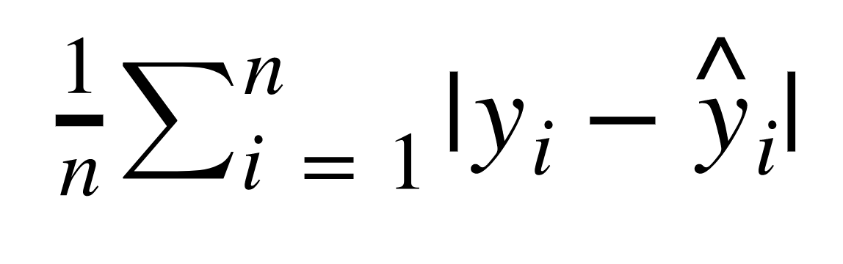
Python and Spark
Mean Absolute Error (MAE)
This is the mean of the absolute value of errors.
Easy to understand, just average error!

Slide 26
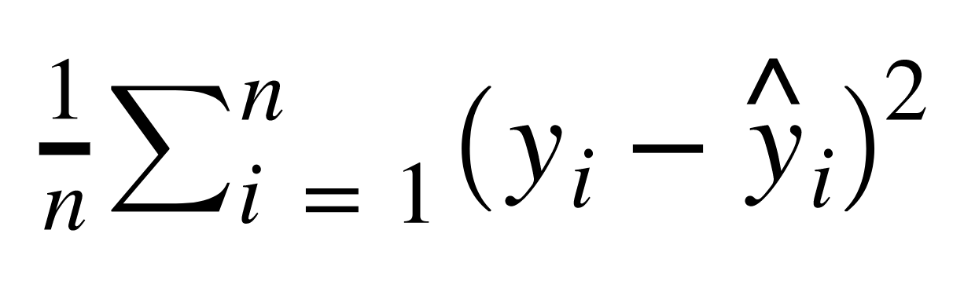
Python and Spark
Mean Squared Error (MSE)
This is the mean of the squared errors.
Larger errors are noted more than with MAE, making MSE more popular.

Slide 27
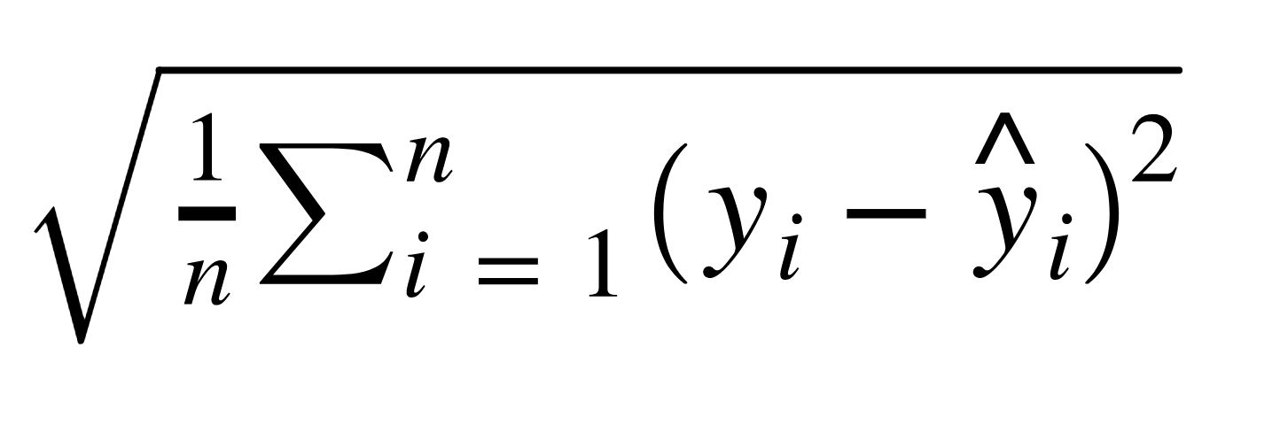
Python and Spark
Root Mean Absolute Error (RMSE)
This is the root of the mean of the squared errors.
Most popular (has same units as y)

Slide 28
Python and Spark
R Squared Values (also known as the coefficient of determination)
Not quite an error metric, more of a statistical measure of your regression model.

Slide 29
Python and Spark
By itself, R² , won’t tell you the “whole story”.
In a basic sense it is a measure of how much variance your model accounts for.
Between 0-1 (0% to 100%)
There are also different ways of obtaining R² , such as adjusted R squared.

Slide 30
Python and Spark
A full analysis and explanation of interpreting R Squared is outside the scope of this course, but check out the resource links for more information on this statistical topic.

Slide 31
Python and Spark
Just keep in mind that R Squared can enhance your understanding of a model, or help you compare models, but it shouldn’t be your sole source of evaluating a model!
Let’s continue on to our code example!

Slide 32
Linear Regression
Custom Code Example
Let’s learn something!

Slide 33
Python and Spark
Now let’s walk through a more realistic example of Linear Regression!
We’ll examine some Ecommerce Customer Data for a company's website and mobile app.

Slide 34
Python and Spark
The main idea will be trying to predict a customer’s total amount expenditure (a continuous money value).
We’ll also discuss how to convert realistic data into a format accepted by Spark’s MLlib!

Slide 35
Python and Spark
The relevant notebook is called:
Linear_Regression_Code_Along
Let’s get started!

Slide 36
Python and Spark
Then we want to see if we can build a regression model that will predict the customer's yearly spend on the company's product.
Let’s get started!

Slide 37
Linear Regression
Consulting Project

Slide 38
Python and Spark
Now let’s set you loose on your first consulting project!
You've been contracted by Hyundai Heavy Industries to help them build a predictive model for some ships.

Slide 39

Python and Spark
You’ve been flown out to their HQ in Ulsan, South Korea!

Slide 40

Python and Spark
It’s one of the world’s largest manufacturers of large ships, including cruise liners!

Slide 41
Python and Spark
They need your help them give accurate estimates of how many crew members a ship will require.
They are currently selling ships to some new customers and want you to create a model and use it to predict how many crew members the ships will need.

Slide 42
Python and Spark
They provided you data with these features:
Ship Name
Cruise Line
Age (as of 2013)
Tonnage (1000s of tons)
passengers (100s)
Length (100s of feet)
Cabins (100s)
Passenger Density
Crew (100s)

Slide 43
Python and Spark
Your job is to create a regression model that will help predict how many crew members will be needed for future ships.
In other words, use the features you think will be useful to predict the value in the Crew column.

Slide 44
Python and Spark
The client also mentioned that they have found that particular cruise lines will differ in acceptable crew counts, so it is most likely an important feature to include in your analysis!

Slide 45
Python and Spark
The cruise line value is a string however!
We haven’t covered exactly how to convert strings to numbers with Python and Spark (yet)
Try to see if you can discover how to use StringIndexer from the documentation!

Slide 46
Python and Spark
As in any real world project, there are no “100% correct” answers here.
Just try your best to build the model!
You can optionally see if you can figure out StringIndexer on your own (we’ll cover it more formally in future lectures)

Slide 47
Python and Spark
This is a pretty open consulting project, feel free to either try it on your own, or go straight to the “solutions” to do a code-along!
There can be more than one way to create this model!

Slide 48
Python and Spark
Best of luck with the project, all of the necessary information for the project can be found in the files:
Linear_Regression_Consulting_Project.ipynb
cruise_line_info.csv

Slide 49
Python and Spark
Best of luck!

Slide 50
Linear Regression
Consulting Project
Example Solution

